Slide 1

Foxglove Deployment
AvOPS Team

Slide 2
Foxglove Introduction
Foxglove Studio is an open-source visualization and debugging tool for your robotics data
It can be run as a standalone desktop app, accessed via your browser, or even self-hosted on your own domain.
Foxglove Studio can be run as a standalone desktop application, accessed in your browser at studio.foxglove.dev, or self-hosted on your own domain.
A Docker image is provided to make self-hosting easy.

Slide 3

Requirement
Deployment of the foxglove instance in Azure tenant and connecting to the file located in the storage account.
Deployment using Azure devops pipeline and terraform module for infrastructure deployment.

Slide 4
Deployment
Manual Deployment :
Creation of container registry via Azure cli
pulling and pushing of the Docker image into the registry
Deployment of web app for the container image
Automated deployment :
Terraform module to create the container registry
Pipeline for docker image build and push to the container registry
Release pipeline for web app deployment.

Slide 5
Manual Deployment Steps – Foxglove pull
az login
az acr create --resource-group rg-avdataops-stg --name acravdataopsfoxglove --sku Basic
az acr login --name acravdataopsfoxglove
docker pull ghcr.io/foxglove/studio:latest
docker tag ghcr.io/foxglove/studio:latest acravdataopsfoxglove.azurecr.io/foxglove:v1
docker push acravdataopsfoxglove.azurecr.io/foxglove:v1

Slide 6
Manual Deployment Steps – Web App Deployment
Once the Container registry is ready, we need to publish this as web app and expose to the world for use
Create User Assigned Managed Identity : az identity create --name avopsGroup --resource-group avops
We have Managed Identity already in the stg resource group
mi-av-dataops-batch-hiniv
Assign acr pull access to Managed Identity : az role assignment create --assignee $principalId --scope $registryId --role "AcrPull“
Create App service Plan :az appservice plan create --name avopsSP --resource-group avops
Create App : az webapp create --resource-group avps --plan avopsSP --name foxgloveapp --deployment-container-image-name mycontainerregistry.azurecr.io/foxglovestudio:v1
Configure web app to use manage identity , assign Web ports and container wait time
Browse to webApp

Slide 7
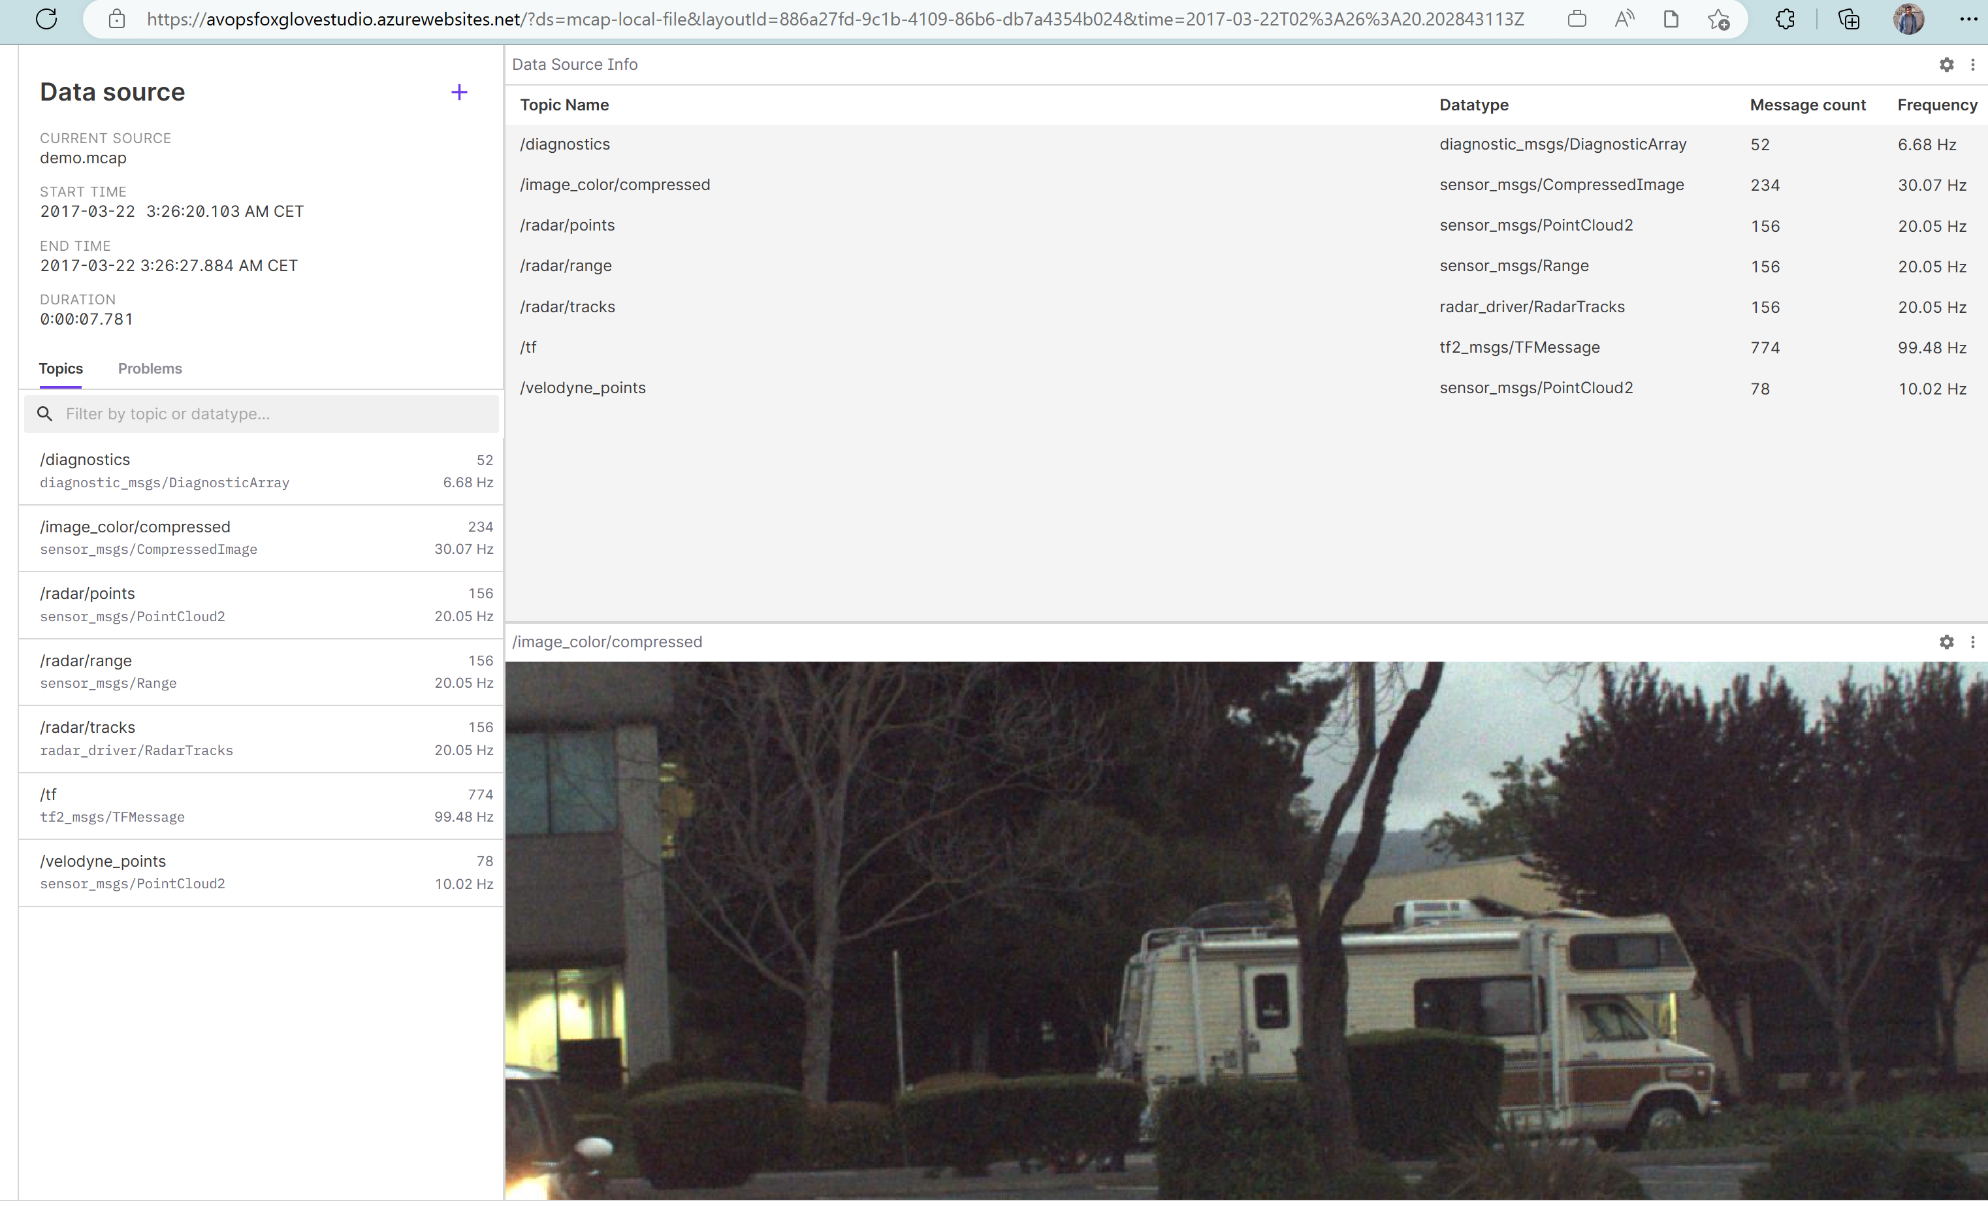
Foxglove App

Slide 8
Automation of Deployment
Pipeline
https://dev.azure.com/chrysalis-innersource/Mobility%20Service%20Line/_git/avops-dataops-foundation?path=/foxglove/.pipelines/ci.yaml
This automatically pulls the containerised foxglove docker file from the public repository and deploy the same in the Azure Container registry. Once the deployment is done same is deployed to webApp.

Slide 9
Automation of Deployment
steps:
1. docker pull $(ghcr_image)
displayName: Pull Foxglove image from GHCR
2. docker tag $(ghcr_image) $(containerRegistry)/$(image_repository):$(Build.BuildId)
displayName: Tagging local Foxglove image
3. task: Docker@2
displayName: Login to ACR
inputs:
command: "login"
containerRegistry: $(acr_service_connection)
4. task: Docker@2
displayName: Push image to ACR
inputs:
command: "push"
containerRegistry: $(acr_service_connection)
repository: $(image_repository)
tags: $(tags)
5. task: AzureWebAppContainer@1
displayName: 'Azure Web App on Container Deploy'
inputs:
azureSubscription: $(azureSubscription)
appName: $(appName)
imageName: $(containerRegistry)/$(image_repository):$(Build.BuildId)

Slide 10
References:
https://learn.microsoft.com/en-us/azure/devops/pipelines/apps/cd/deploy-docker-webapp?view=azure-devops&tabs=java%2Cyaml
https://learn.microsoft.com/en-us/azure/app-service/tutorial-custom-container?tabs=azure-cli&pivots=container-linux

